Slide 1
Tata data visualization
File created on: 5/5/2024 5:05:36 AM

Slide 2
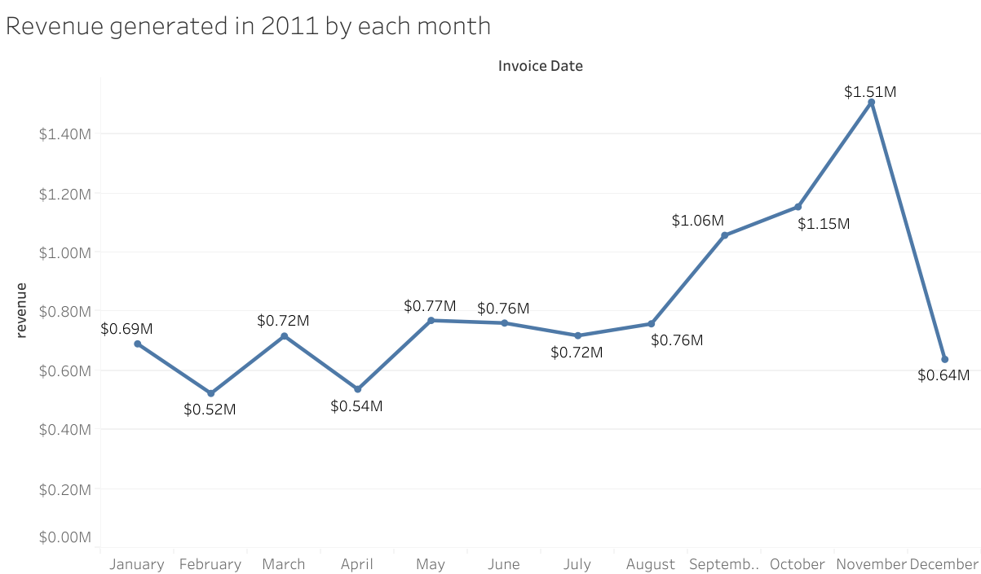

Slide 3
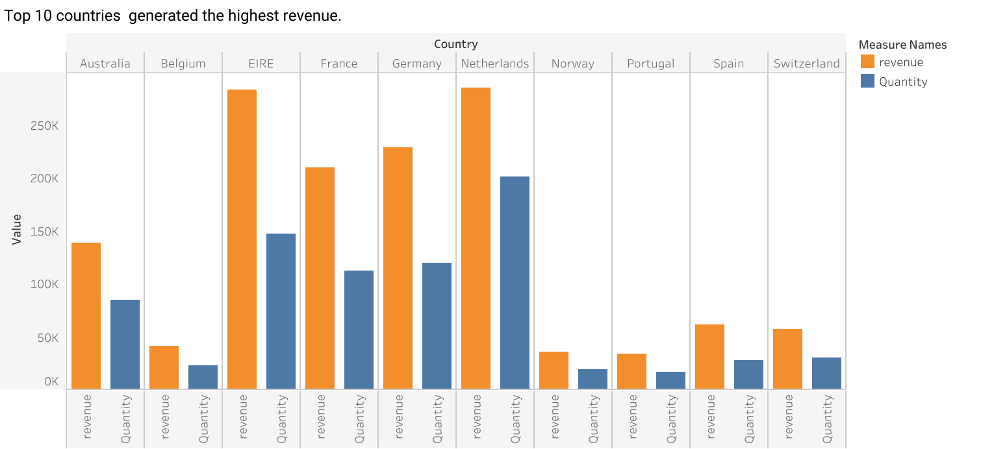

Slide 4
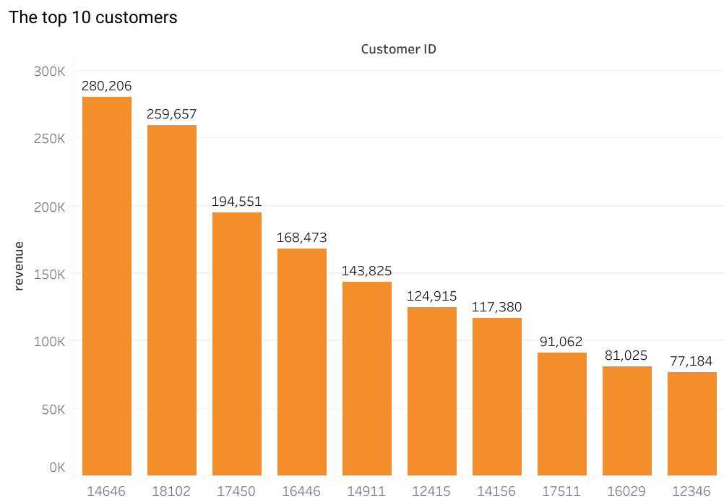

Slide 5
